Slide 1


Software Quality Assurance
Pavithra Subashini
Senior lecturer
Department of Computer Science and Software Engineering
Faculty of Computing

Slide 2
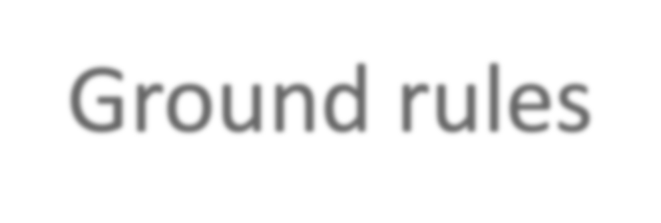
Ground rules
Interactivity is must
Proactivity is expected
No mobile phones during lecture
Allow access to digital devices during activities
Activity based learning

Slide 3
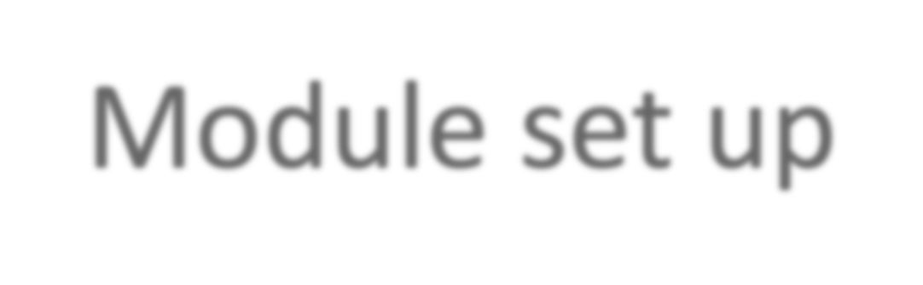
Module set up
Two-hour lectures per week – Activity based learning
One-hour tutorial
At the end of the module you will be able to ensure the quality of the software project.
Encourage self study
– Research on SQA field
Industrial changes/ adoption to the changes.
* ex: Modernizing Quality Assurance
Aligning organizational views on quality to customers expectations

Slide 4
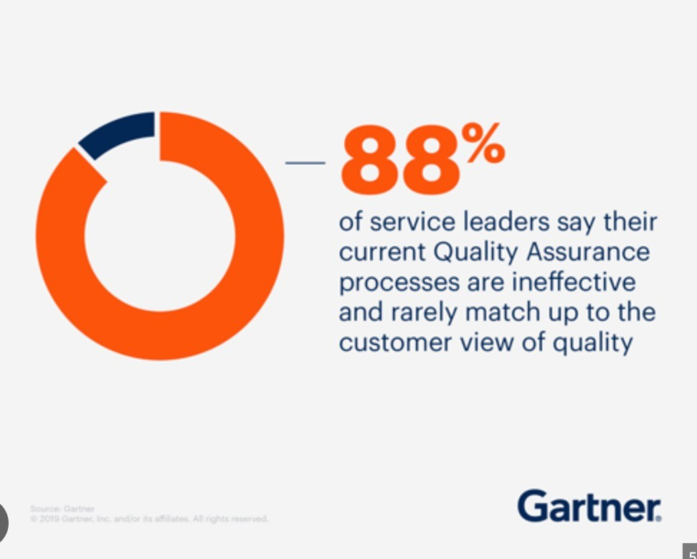
Demand for QA

Slide 5

An effective quality process must focus on
Paying much attention to customer’s requirements
Making efforts to continuously improve quality
Integrating measurement processes with product design and development
Pushing the quality concept down to the lowest level of the organization
Developing a system-level perspective with an emphasis on methodology and process
Eliminating waste through continuous improvement

Slide 6

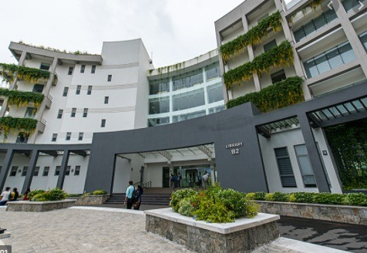
Reference book
https://www.istqb.org/downloads.html
Refer latest books from NSBM Library

Slide 7
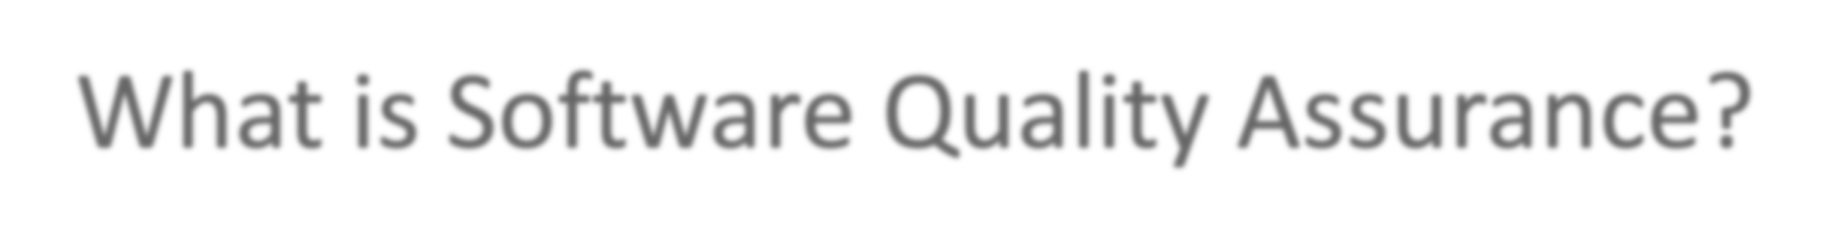
What is Software Quality Assurance?
“Set of activities to ensure the quality in software engineering processes.”
It ultimately result in quality software products.
The activities establish and evaluate the processes that produce products.
It involves process-focused action.

Slide 8

What is testing?
“Method to check whether the actual software product matches expected requirements and to ensure that software product is Defect free.”
It involves execution of software/system components by manual or automated tools
The purpose of software testing is to identify errors, gaps or missing requirements in contrast to actual requirements

Slide 9
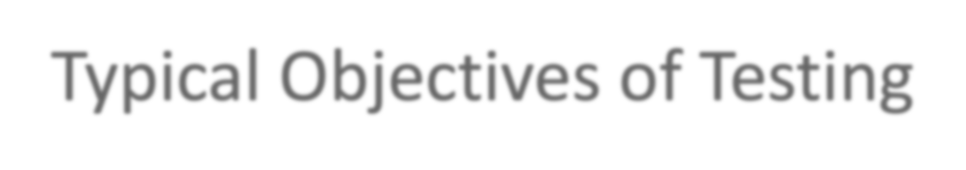
Typical Objectives of Testing
To prevent defects by evaluate work products such as requirements, user stories, design, and code
To verify whether all specified requirements have been fulfilled
To check whether the test object is complete and validate if it works as the users and other stakeholders expect
To build confidence in the level of quality of the test object

Slide 10

Typical Objectives of Testing
To find defects and failures thus reduce the level of risk of inadequate software quality
To provide sufficient information to stakeholders to allow them to make informed decisions, especially regarding the level of quality of the test object
To comply with contractual, legal, or regulatory requirements or standards, and/or to verify the test object’s compliance with such requirements or standards

Slide 11
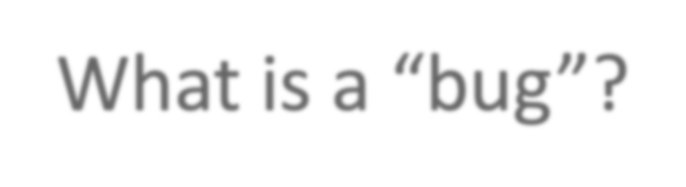
What is a “bug”?
Error: a human action that produces an incorrect result
Fault: a manifestation of an error in software
also known as a defect or bug
if executed, a fault may cause a failure
Failure: deviation of the software from its expected delivery or service
(found defect)
Failure is an event; fault is a state of the software, caused by an error

Slide 12



Error - Fault - Failure
A person makes an error ...
… that creates a fault in the software ...
… that can cause a failure
in operation

Slide 13
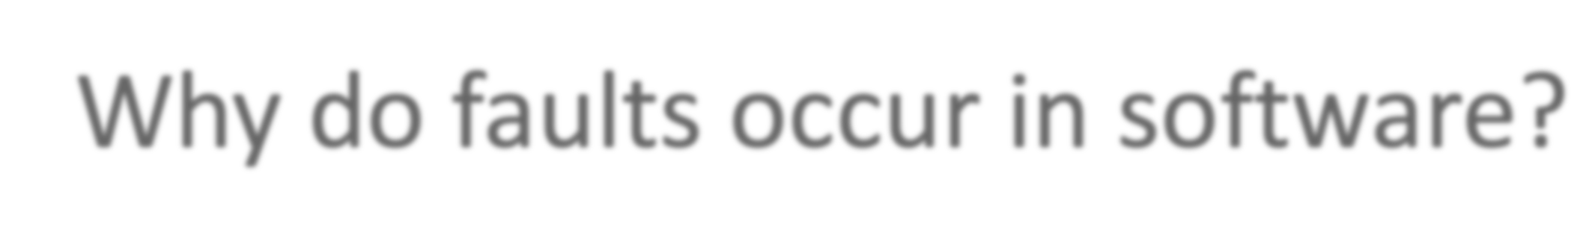
Why do faults occur in software?
software is written by human beings
who know something, but not everything
who have skills, but aren’t perfect
who do make mistakes (errors)
under increasing pressure to deliver to strict deadlines
no time to check but assumptions may be wrong
systems may be incomplete

Slide 14
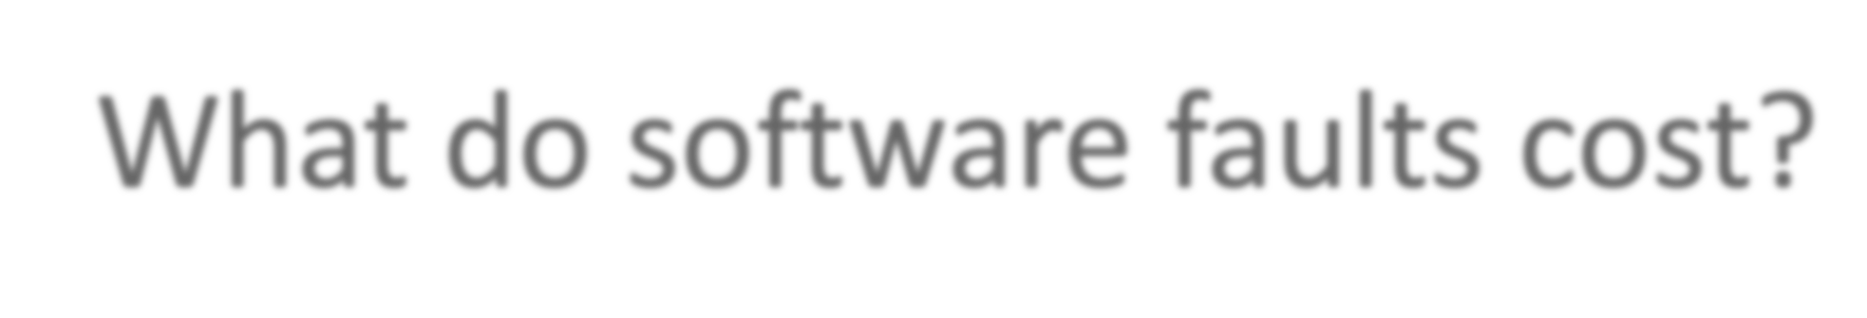
What do software faults cost?
Do search ,you will find lots of interesting facts
huge sums
Ariane 5 ($7billion)
Mariner space probe to Venus ($250m)
American Airlines ($50m)
very little or nothing at all
minor inconvenience
no visible or physical detrimental impact
software is not “linear”:
small input may have very large effect

Slide 15
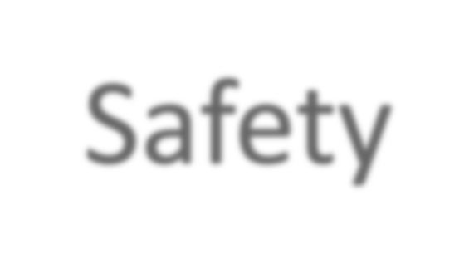

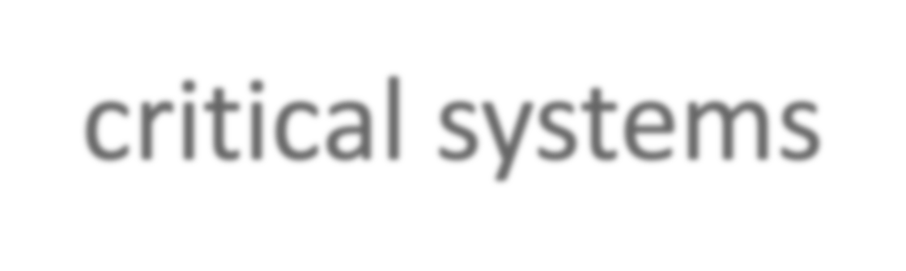
Safety-critical systems
software faults can cause death or injury
radiation treatment kills patients (Therac-25)
train driver killed
aircraft crashes (Airbus & Korean Airlines)
bank system overdraft letters cause suicide

Slide 16

Reliability versus faults
Reliability: the probability that software will not cause the failure of the system for a specified time under specified conditions
Can a system be fault-free? (zero faults, right first time)
Can a software system be reliable but still have faults?
Is a “fault-free” software application always reliable?

Slide 17

So why is testing necessary?
because software is likely to have faults
to learn about the reliability of the software
to fill the time between delivery of the software and the release date
to prove that the software has no faults
because testing is included in the project plan
because failures can be very expensive
to avoid being sued by customers
to stay in business

Slide 18



Slide 19
In class activity- Individual
Identify global top 10 software defetcs due to lack of testing.
Submit answers to DLE.

Slide 20


